Slide 1
Data Structures
Programming Project #2
郭建志

Slide 2
Data Center
A data center consists of multiple severs
The servers are connected by switches in a local area network
destination
source

Slide 3
Switches
Each switch has multiple ports
Receive and forward the packets from a port to another port

Slide 4
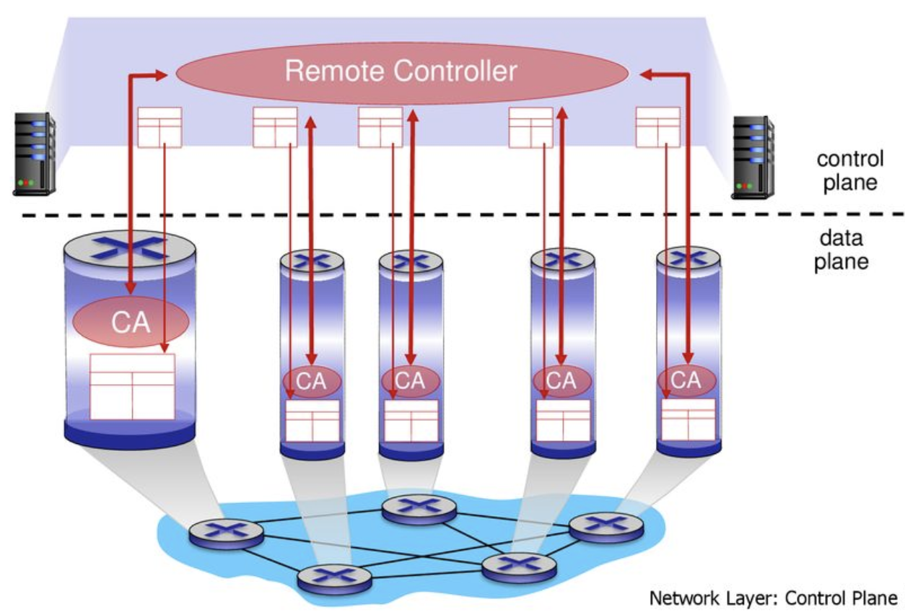
SDN-enabled Switches
A centralized controller is introduced – software-defined networking (SDN)

Slide 5
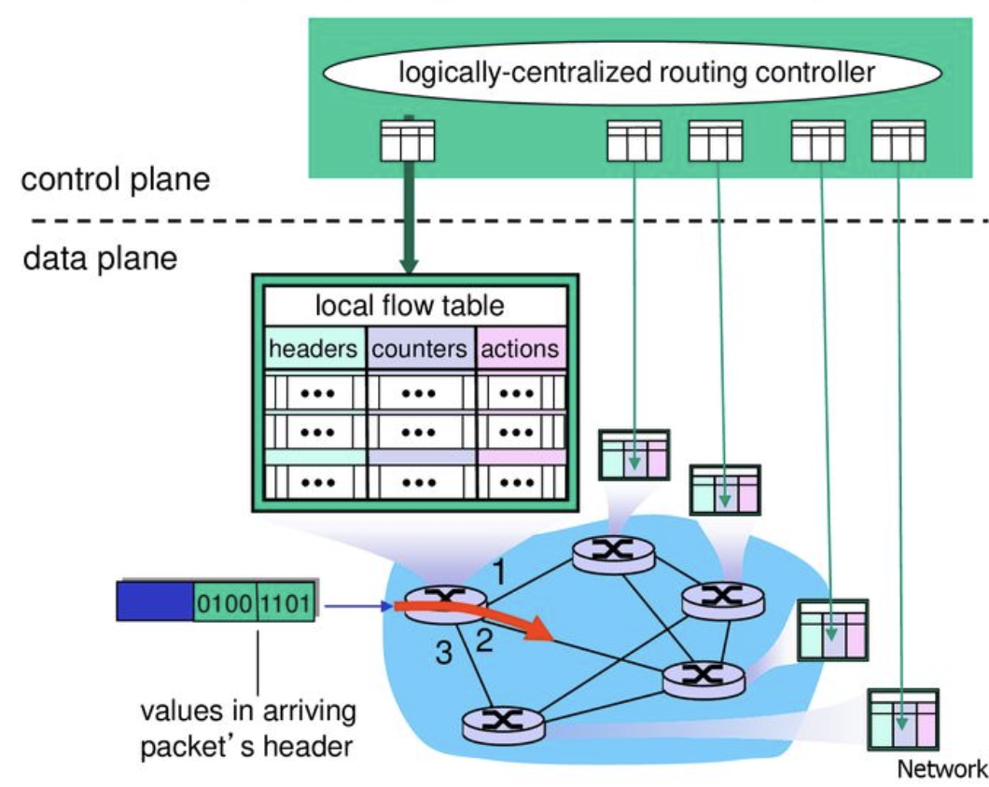
Installing Rules in the SDN-enabled Switches

Slide 6
Routing Path Update (aka Network Update)
Given the old and new routing paths
Update the routing paths
3
4
3
4
0
1
2
0
1
2
0 | 1 | 2 | 3 | 4
1 | 2 | 4 | -1 | -1
0 | 1 | 2 | 3 | 4
2 | 3 | 1 | 4 | -1

Slide 7
Difficulty of Network Update in SDN
The controller is logically-centralized
However, the underlying mechanism is distributed
Each switch receives the update message and updates its rule independently and asynchronously
drop
3
4
3
4
0
1
2
0
1
2
0 | 1 | 2 | 3 | 4
1 | 2 | 4 | -1 | -1
0 | 1 | 2 | 3 | 4
1 | 3 | 4 | -1 | -1

Slide 8
Difficulty of Network Update in SDN
The controller is logically-centralized
However, the underlying mechanism is distributed
Each switch receives the update message and updates its rule independently and asynchronously
How to solve the issue?
Two-phase commit (SIGCOMM 2012)
Round-based update (TON, 2018)
“Survey of Consistent Software-Defined Network Updates”, in IEEE Communications Surveys & Tutorials, 2019

Slide 9

Difficulty of Network Update in SDN
Two-phase commit (SIGCOMM 2012)
Drawback: waste the TCAM size during the update
match
C
D
3
4
#Final
#Initial
match
#F
S
#T
A
B
0
1
2
match
match

Slide 10
Difficulty of Network Update in SDN
Round-based update (單純概念介紹)
Step 2: Update 1
3
4
3
4
0
1
2
0
1
2
Step 1: Update 0 and 3
Step 3: Update 2
3
4
3
4
0
1
2
0
1
2

Slide 11
Programming Project #2: Minimize the number of update rounds
Input:
Numbers of nodes in old and new paths
Nodes in old and new paths
Procedure:
Minimize the rounds of update
Output:
Rules of each switch in each round
The grade is inversely proportional to the number of rounds

Slide 12
Programming Project #2: Minimize the number of update rounds
Input:
Numbers of nodes in old and new paths
Nodes in old and new paths
Procedure:
Minimize the rounds of update
Output:
Rules of each switch in each round
The grade is inversely proportional to the number of rounds
…

Slide 13
Programming Project #2: Minimize the number of update rounds
Input:
Numbers of nodes in old and new paths
Nodes in old and new paths
Procedure:
Minimize the rounds of update
Output:
Rules of each switch in each round
The grade is inversely proportional to the number of rounds
怎麼辦

Slide 14
Programming Project #2: Minimize the number of update rounds
Input:
Numbers of nodes in old and new paths
Nodes in old and new paths
Procedure:
Minimize the rounds of update
Output:
Rules of each switch in each round
The grade is inversely proportional to the number of rounds
早知道不加簽了

Slide 15
Programming Project #2: Round-based network update
Input:
Numbers of nodes in old and new paths
Nodes in old and new paths
Procedure:
Compute each round of update
Output:
Rules of each switch in each round
Implement a given algorithm.
禮拜四
告訴你

Slide 16
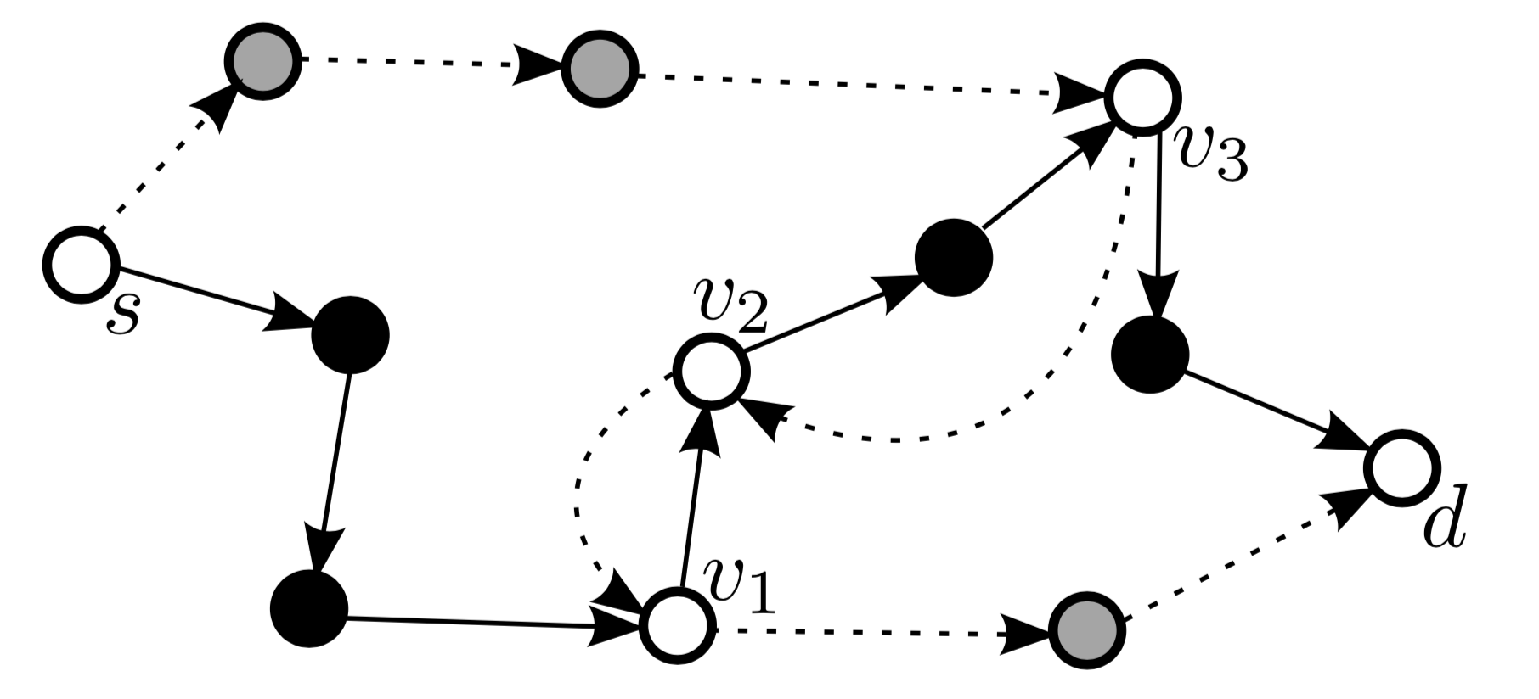
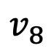
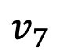
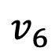
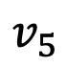
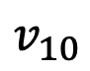
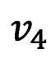
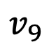
Round-Based Update Algorithm (TON, 2018)
Solid line: old path Dashed line: new path
s | 1 | 2 | 3 | 4 | 5 | 6 | 7 | 8 | 9 | 10 | d
7 | 2 | 9 | 10 | -1 | -1 | -1 | 8 | 1 | 3 | d | -1
$$v_{4}$$
$$v_{5}$$
$$v_{9}$$
$$v_{7}$$
$$v_{10}$$
$$v_{8}$$
$$v_{6}$$
s | 1 | 2 | 3 | 4 | 5 | 6 | 7 | 8 | 9 | 10 | d
4 | 6 | 1 | 2 | 5 | 3 | d | -1 | -1 | -1 | -1 | -1

Slide 17
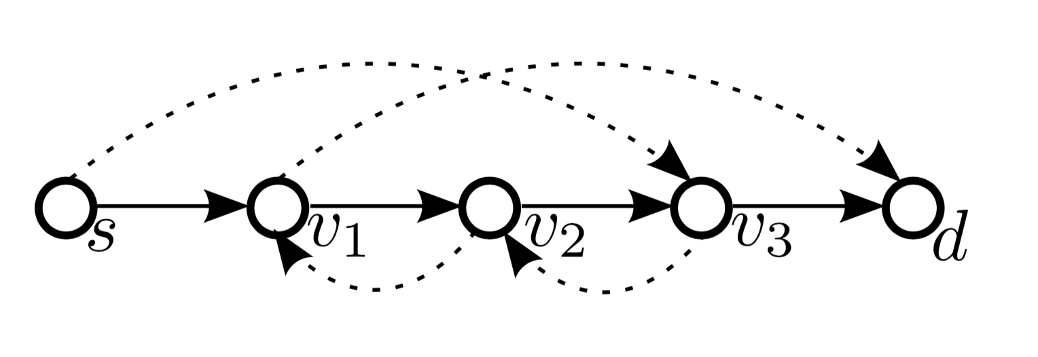
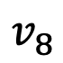
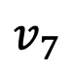
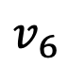
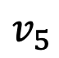
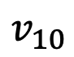
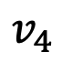
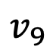
Round-Based Update Algorithm (TON, 2018)
Solid line: old path Dashed line: new path
Add the rules in red nodes in the first round
Remove the rules in black nodes in the last round
➔ Reduce the the network to the line representation
$$v_{4}$$
$$v_{5}$$
They didn’t receive before update
They will not receive after update
$$v_{9}$$
$$v_{7}$$
$$v_{10}$$
$$v_{8}$$
$$v_{6}$$

Slide 18
Round-Based Update Algorithm (TON, 2018)
Solid line: old path Dashed line: new path
Add the rules in red nodes in the first round
Remove the rules in black nodes in the last round
➔ Reduce the the network to the line representation
s | 1 | 2 | 3 | 4 | 5 | 6 | 7 | 8 | 9 | 10 | d
7 | 2 | 9 | 10 | 5 | 3 | d | 8 | 1 | 3 | d | -1
0th round

Slide 19
Round-Based Update Algorithm (TON, 2018)
Solid line: old path Dashed line: new path
Add the rules in red nodes in the first round
Remove the rules in black nodes in the last round
➔ Reduce the the network to the line representation
s | 1 | 2 | 3 | 4 | 5 | 6 | 7 | 8 | 9 | 10 | d
4 | 2 | 9 | 10 | 5 | 3 | d | 8 | 1 | 3 | d | -1
1nd round

Slide 20
Round-Based Update Algorithm (TON, 2018)
Solid line: old path Dashed line: new path
Add the rules in red nodes in the first round
Remove the rules in black nodes in the last round
➔ Reduce the the network to the line representation
s | 1 | 2 | 3 | 4 | 5 | 6 | 7 | 8 | 9 | 10 | d
4 | 6 | 1 | 10 | 5 | 3 | d | 8 | 1 | 3 | d | -1
2nd round

Slide 21
Round-Based Update Algorithm (TON, 2018)
Solid line: old path Dashed line: new path
Add the rules in red nodes in the first round
Remove the rules in black nodes in the last round
➔ Reduce the the network to the line representation
s | 1 | 2 | 3 | 4 | 5 | 6 | 7 | 8 | 9 | 10 | d
4 | 6 | 1 | 2 | 5 | 3 | d | 8 | 1 | 3 | d | -1
3rd round

Slide 22
Round-Based Update Algorithm (TON, 2018)
Solid line: old path Dashed line: new path
Add the rules in red nodes in the first round
Remove the rules in black nodes in the last round
➔ Reduce the the network to the line representation
s | 1 | 2 | 3 | 4 | 5 | 6 | 7 | 8 | 9 | 10 | d
4 | 6 | 1 | 2 | 5 | 3 | d | -1 | -1 | -1 | -1 | -1
4th round

Slide 23
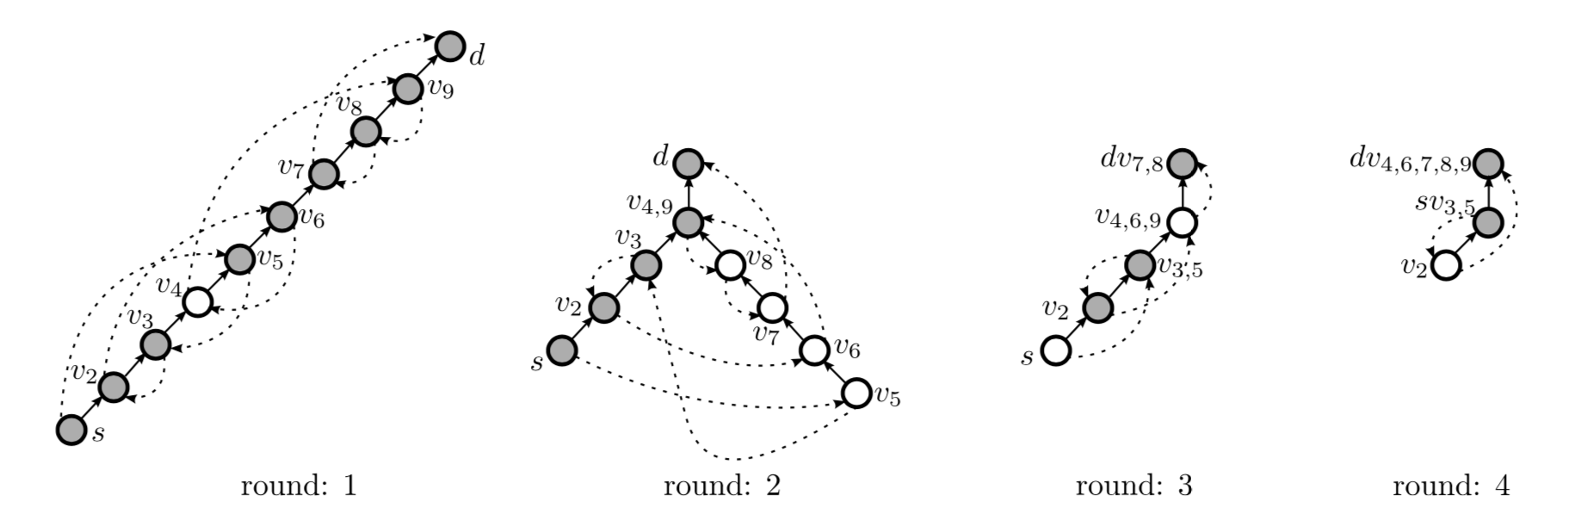
Round-Based Update Algorithm (TON, 2018)
Shortcut phase: used in odd rounds
In each round, we iteratively select the edge that has the farthest reaching distance and does not interfere with the selected edge until there is no such edge
# selected edges >= 1 → Update the selected edges

Slide 24
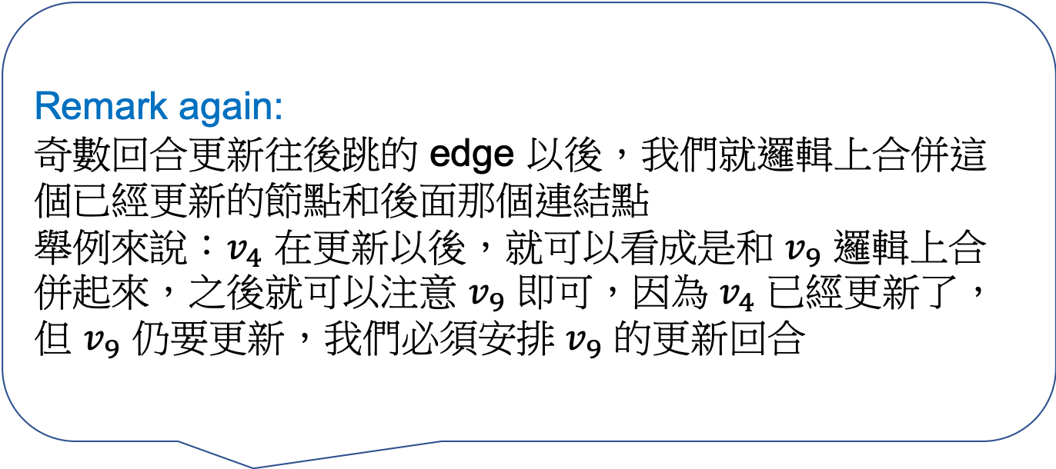
Round-Based Update Algorithm (TON, 2018)
Remark again: 奇數回合更新往後跳的 edge 以後，我們就邏輯上合併這個已經更新的節點和後面那個連結點
舉例來說：$v_{4}$ 在更新以後，就可以看成是和 $v_{9}$ 邏輯上合併起來，之後就可以注意 $v_{9}$ 即可，因為 $v_{4}$ 已經更新了，但 $v_{9}$ 仍要更新，我們必須安排 $v_{9}$ 的更新回合
Shortcut phase: used in odd rounds
In each round, we iteratively select the edge that has the farthest reaching distance and does not interfere with the selected edge until there is no such edge
# selected edges >= 1 → Update the selected edges

Slide 25
Round-Based Update Algorithm (TON, 2018)
Prune phase: used in even rounds
Update all nodes that are not on the current path from the source to the destination
They can be updated in the same round since they don’t receive any packet after the 1st round

Slide 26
Round-Based Update Algorithm (TON, 2018)
Peacock algorithm Repeat the two phase until all nodes are updated
Shortcut phase: used in odd rounds
Prune phase: used in even rounds

Slide 27
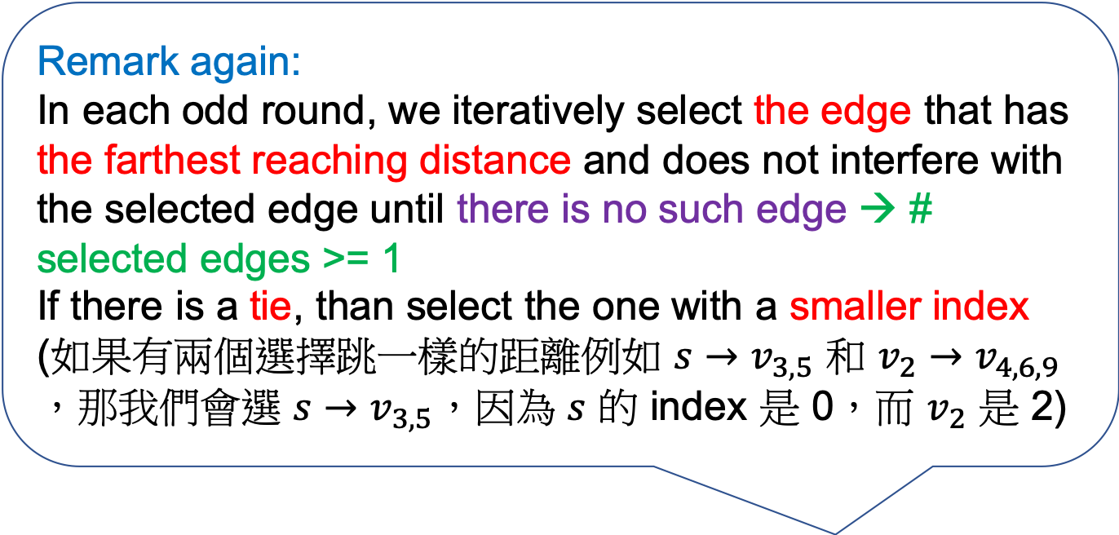
Round-Based Update Algorithm (TON, 2018)
Remark again: In each odd round, we iteratively select the edge that has the farthest reaching distance and does not interfere with the selected edge until there is no such edge → # selected edges >= 1
If there is a tie, than select the one with a smaller index (如果有兩個選擇跳一樣的距離例如 $s→v_{3,5}$ 和 $v_{2}→v_{4,6,9}$，那我們會選 $s→v_{3,5}$，因為 $s$ 的 index 是 0，而 $v_{2}$ 是 2)
Peacock algorithm Repeat the two phase until all nodes are updated
Shortcut phase: used in odd rounds
Prune phase: used in even rounds

Slide 28
Discussion
Minimizing the number of update rounds is NP-hard
You cannot find an efficient algorithm for this problem unless NP = P
There are many heuristic algorithms
“Loop-Free Route Updates for Software-Defined Networks,” in IEEE/ACM TON 2018 (你們要實作的）
…

Slide 29
Input Sample: input.txt
Format:
#Nodes
Path1
Path2
e.g.,
12
7 2 9 10 -1 -1 -1 8 1 3 11 -1
4 6 1 2 5 3 11 -1 -1 -1 -1 -1
s | 1 | 2 | 3 | 4 | 5 | 6 | 7 | 8 | 9 | 10 | d
7 | 2 | 9 | 10 | -1 | -1 | -1 | 8 | 1 | 3 | d | -1
s | 1 | 2 | 3 | 4 | 5 | 6 | 7 | 8 | 9 | 10 | d
4 | 6 | 1 | 2 | 5 | 3 | d | -1 | -1 | -1 | -1 | -1

Slide 30
Output Sample: use printf
s | 1 | 2 | 3 | 4 | 5 | 6 | 7 | 8 | 9 | 10 | d
7 | 2 | 9 | 10 | -1 | -1 | -1 | 8 | 1 | 3 | d | -1
s | 1 | 2 | 3 | 4 | 5 | 6 | 7 | 8 | 9 | 10 | d
7 | 2 | 9 | 10 | 5 | 3 | d | 8 | 1 | 3 | d | -1
Format:
#Rounds
Path1
Path2
…
e.g.,
6
7 2 9 10 -1 -1 -1 8 1 3 11 -1
7 2 9 10 5 3 11 8 1 3 11 -1
4 2 9 10 5 3 11 8 1 3 11 -1
4 6 1 10 5 3 11 8 1 3 11 -1
4 6 1 2 5 3 11 8 1 3 11 -1
4 6 1 2 5 3 11 -1 -1 -1 -1 -1
s | 1 | 2 | 3 | 4 | 5 | 6 | 7 | 8 | 9 | 10 | d
4 | 2 | 9 | 10 | 5 | 3 | d | 8 | 1 | 3 | d | -1
s | 1 | 2 | 3 | 4 | 5 | 6 | 7 | 8 | 9 | 10 | d
4 | 6 | 1 | 10 | 5 | 3 | d | 8 | 1 | 3 | d | -1
s | 1 | 2 | 3 | 4 | 5 | 6 | 7 | 8 | 9 | 10 | d
4 | 6 | 1 | 2 | 5 | 3 | d | 8 | 1 | 3 | d | -1
s | 1 | 2 | 3 | 4 | 5 | 6 | 7 | 8 | 9 | 10 | d
4 | 6 | 1 | 2 | 5 | 3 | d | -1 | -1 | -1 | -1 | -1

Slide 31
Note
Superb deadline: 10/22 Tue
Deadline: 10/29 Tue
Submit your code to E-course2
Demonstrate your code in 工院1館 401B
C Source code
Show a good programming style

